Slide 1

GOOGLE ANALYTICS 4 (GA4) AND
MARKETING PERFORMANCE ANALYSIS
Submitted by: Sooraj Suresh

Slide 2
Executive Summary
Core Objective: Bridging the gap between high-volume traffic and qualified lead generation.
The Lead Paradox: While Direct traffic provides the highest volume of new leads (over 500), it has one of the lowest User Key Event Rates.
The Conversion Engine: Paid Social and Cross-network channels demonstrate the highest conversion efficiency despite lower traffic volumes.
The Engagement Hurdle: Massive drop-offs occur between Page Views (129k+) and meaningful actions like Scrolls (14k) or Form Starts (3k).

Slide 3
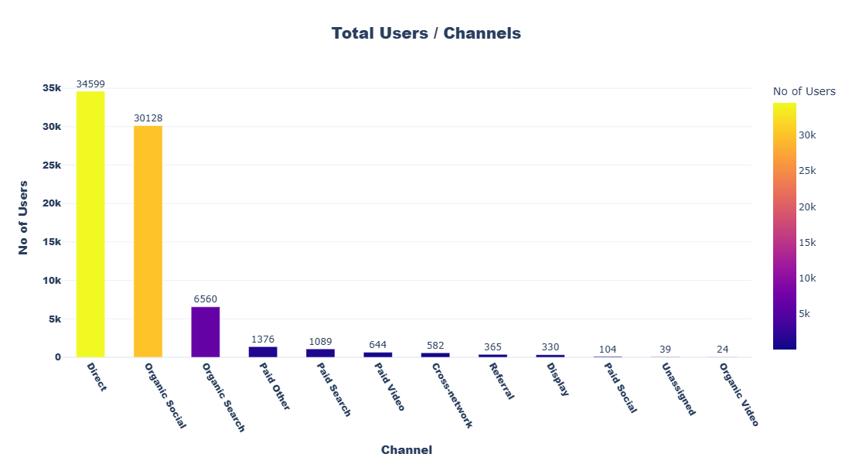
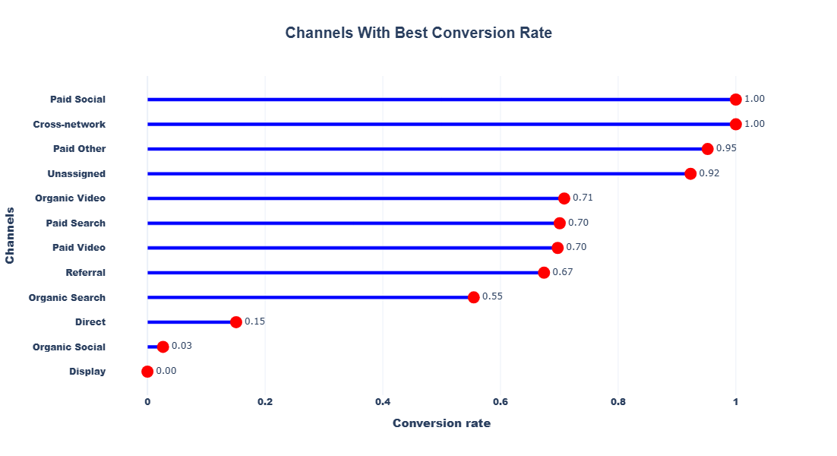
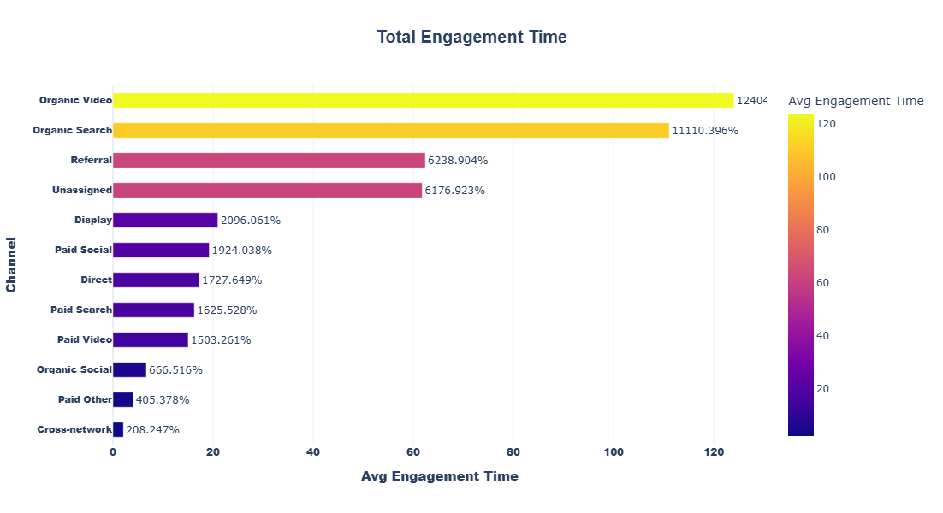
Acquisition overview – Traffic Drivers
Key Findings
Direct & Organic Social drive the highest traffic, showing strong brand awareness.
High-volume channels underperform on conversions, indicating lower traffic quality.
Paid Social & Cross-network deliver the best conversion rates despite low volume (high intent).
Organic Video & Organic Search show the strongest engagement and consideration behavior.
Long-tail channels bring low traffic but high quality, suggesting optimization or selective scaling

Slide 4
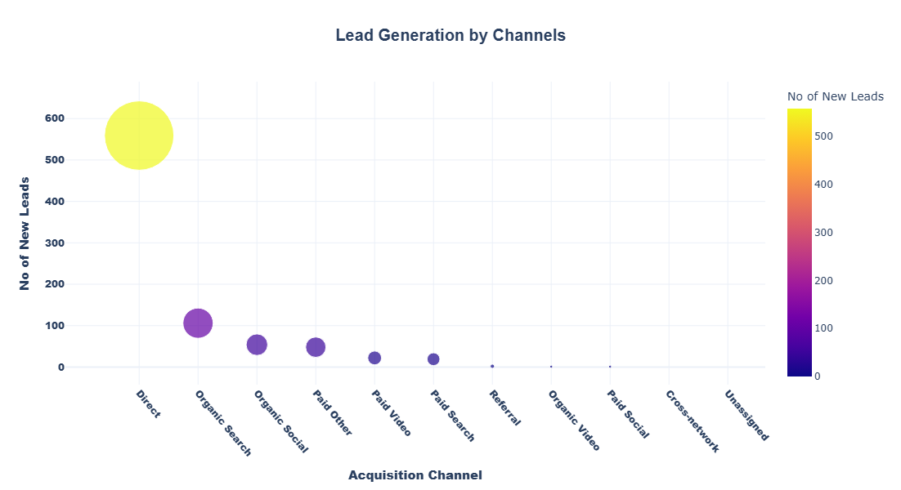
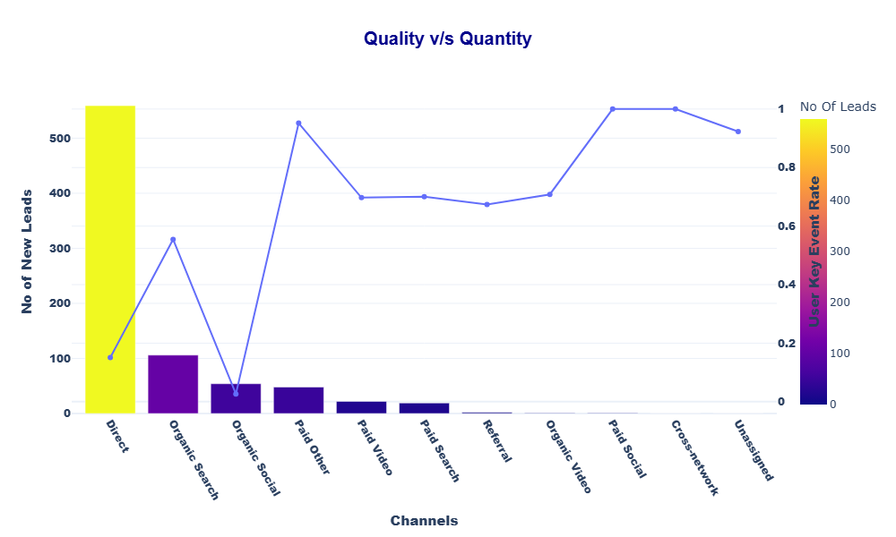
Lead Acquisition Overview
Key Findings
Direct drives the most leads but with lower quality.
Organic Search offers the best balance of volume and quality.
Paid channels generate fewer but higher-quality leads (strong intent).
Low-volume channels show very high quality, indicating scaling potential.
Organic Social delivers moderate volume with inconsistent quality.
Overall: Growth is volume-led; quality-driven channels are underutilized.

Slide 5
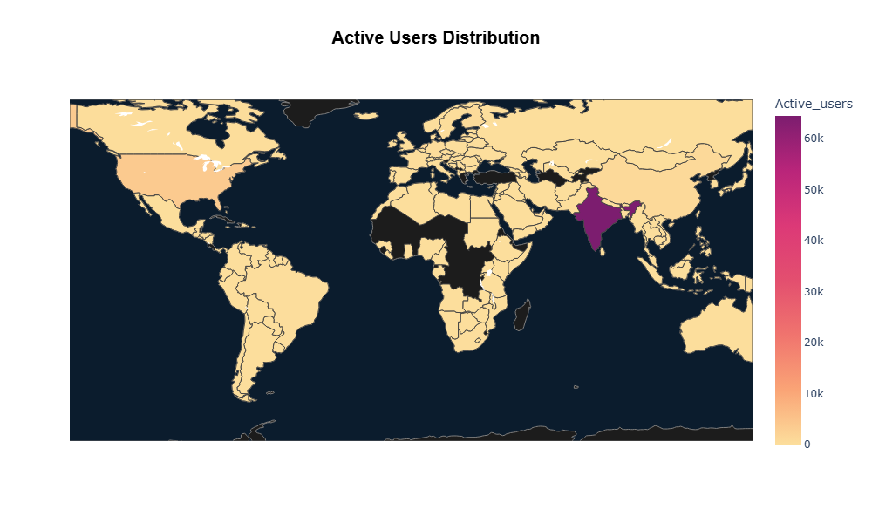
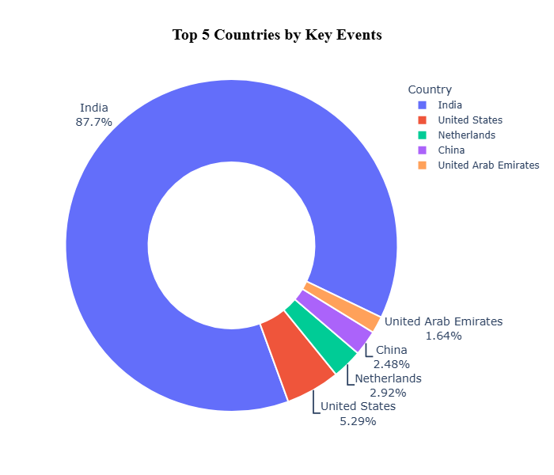
Geographic Performance
Key Findings
India dominates traffic and conversions (88%), making it the primary market.
United States is the strongest secondary market with clear growth potential.
Other countries contribute marginally, indicating early-stage presence.
Engagement and conversions are concentrated in a few key geographies.
Opportunity: Scale India and the US; selectively test localized strategies in other regions.

Slide 6
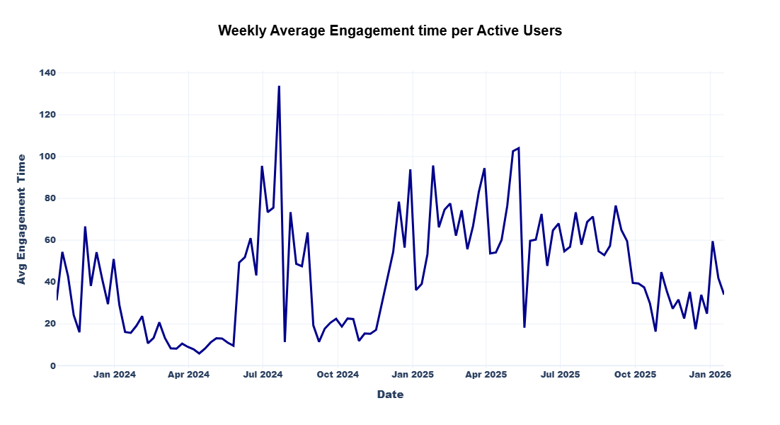
Engagement Overview
Analysis starts from each user’s first active day to remove zero-activity bias.
Key Findings
Early engagement is volatile, showing inconsistent initial behavior.
Periodic spikes indicate campaign or content-driven activity.
Post mid-2024, engagement stabilizes at a higher level.
Overall trend: User engagement has matured from spikes to sustained interaction.

Slide 7
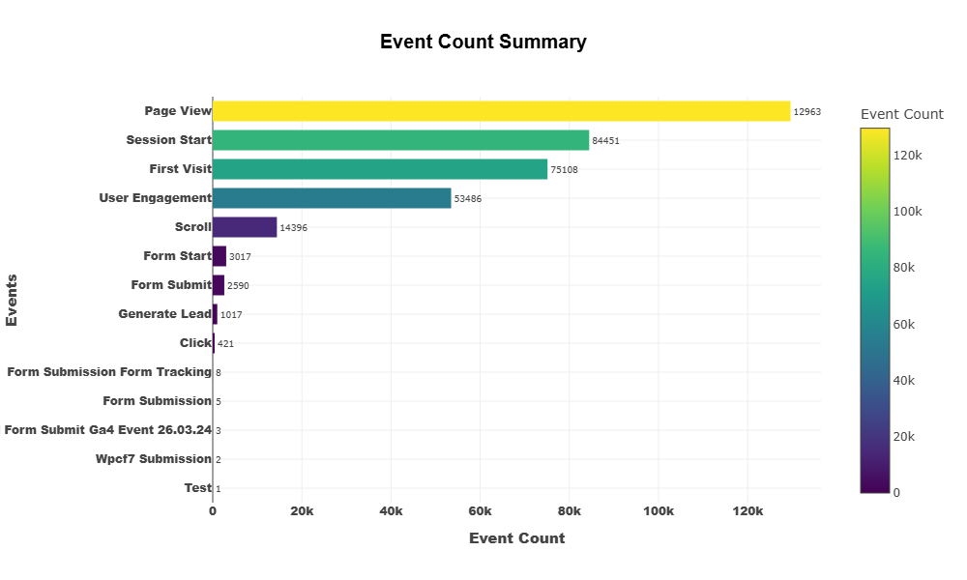
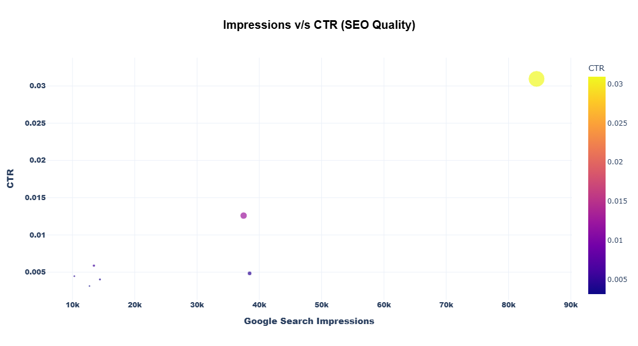
Events & SEO Performance
Key Findings
Strong top-of-funnel: High page views but sharp engagement drop, indicating passive consumption.
Conversion friction: Form starts exceed submissions, pointing to UX or form issues.
Low lead yield: Engagement is high, but lead generation remains limited.
SEO performance varies: High-CTR keywords drive most clicks, showing strong relevance.
Optimization opportunity: High-impression, low-CTR keywords need SERP and intent improvements.

Slide 8
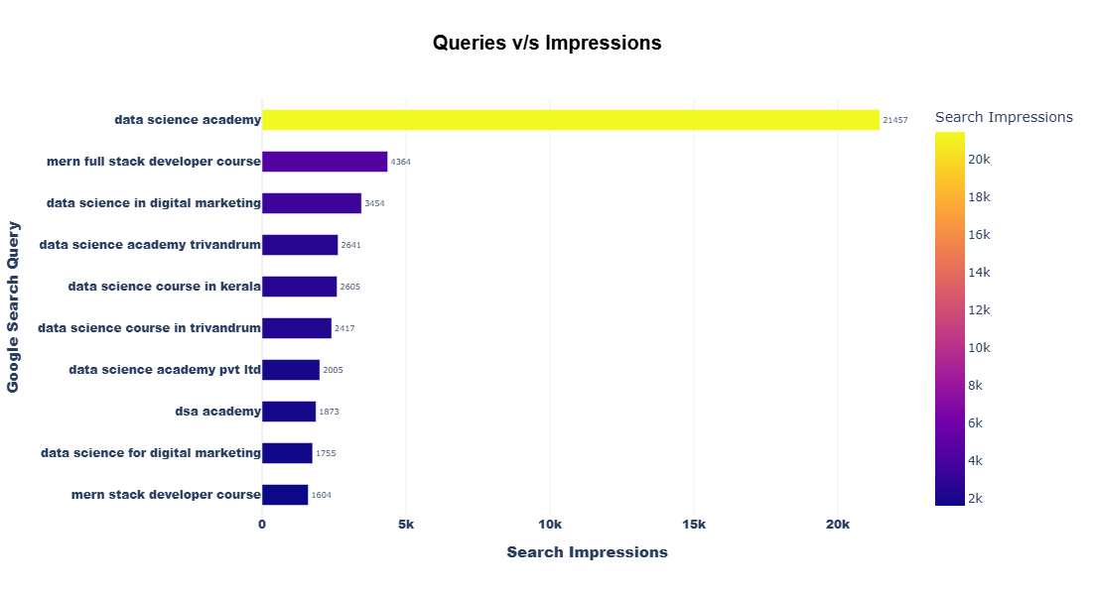
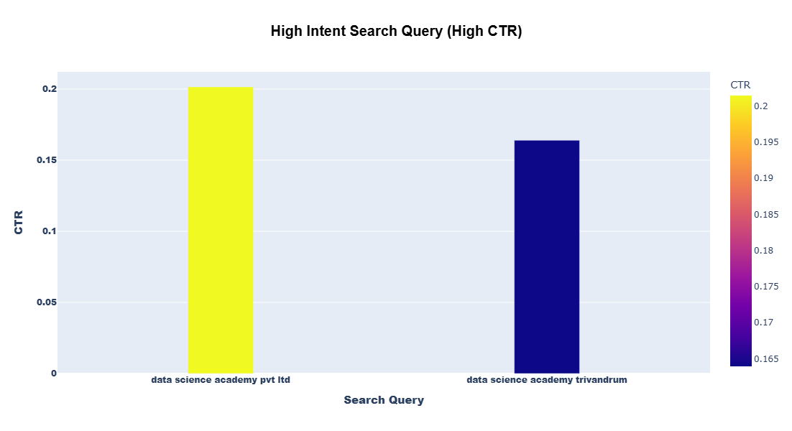
SEO Performance
Key Findings
Organic visibility is brand-led, with “Data science academy” driving most impressions.
Branded and location-based queries show very high CTR and strong intent.
Non-branded queries have lower scale, indicating SEO growth potential.
Opportunity: Scale non-branded/course keywords while protecting branded search.

Slide 9
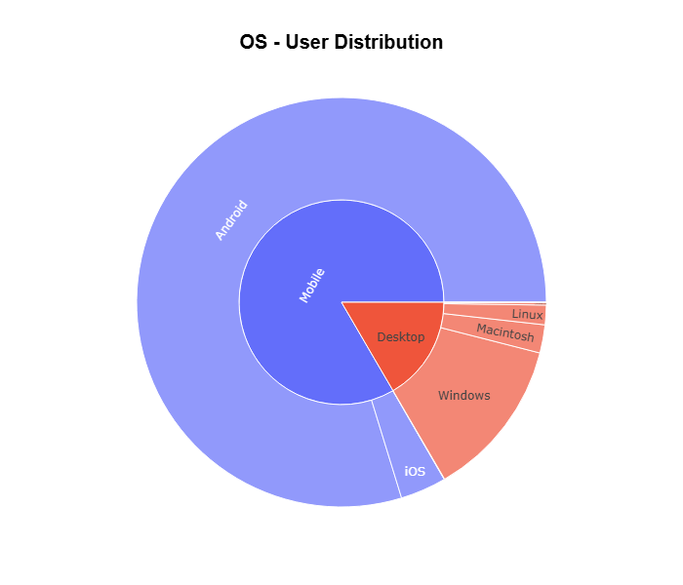
Technology & Devices Overview
Key Findings
Mobile dominates usage, making a mobile-first experience critical.
Android leads mobile traffic, requiring priority optimization.
Desktop (Windows) remains relevant for research and form submissions.
Tablet & Smart TV traffic is negligible and low priority.
User activity clusters around one mobile resolution, reinforcing responsive design focus.

Slide 10
STRATEGIC RECOMMENDATIONS FOR STAKEHOLDERS
Shift from Volume-Led to Quality-Led Growth
  Rebalance acquisition strategy to prioritize high-intent, high-conversion channels (Paid Social, Paid Video, Cross-network) rather than over-relying on Direct and Organic Social.
  Success metric should move from users/sessions → qualified leads & key event rate.
2. Scale High-Efficiency Paid Channels in a Controlled Manner
  Incrementally increase budgets for Paid Social, Paid Video, and Cross-network, which show superior conversion efficiency despite low volumes.
  Use small A/B budget increments to preserve lead quality while scaling.
3. Optimize Direct Traffic Conversion Paths
  Direct traffic shows strong brand pull but weak conversion efficiency.
  Improve:
    Landing page clarity
    Above-the-fold CTAs
    Trust signals (testimonials, placements, certifications)
  Objective: convert existing brand demand more efficiently.

Slide 11
4. Strengthen Organic Search as the Core Sustainable Channel
  Organic Search offers the best balance of volume + quality.
  Invest further in:
    Non-branded, course-specific keywords
    Comparison and decision-stage content (e.g., “Best data science course in India”)
  Protect branded keywords while expanding non-branded reach.
5. Fix Conversion Friction in the Lead Funnel
  Large drop between form starts and submissions indicates UX barriers.
  Recommended actions:
    Reduce form fields
    Enable autofill
    Improve error handling & load speed
    Add progress indicators
  This is one of the fastest ROI opportunities.
6. Leverage Organic Video & Content for Consideration-Stage Users
  Organic Video and Organic Search users show high engagement.
  Add:
    Strong mid-content CTAs
    Retargeting pixels
    Lead magnets (brochures, webinars, demo classes)
  Convert engagement into leads without increasing traffic spend.

Slide 12
7. Geo-Focused Growth Strategy
  India should remain the primary investment market due to dominant conversions.
  United States shows strong secondary potential:
    Launch localized landing pages
    Use US-specific testimonials, pricing, and time zones
  Test light SEO & paid pilots in Netherlands, UAE, and China before scaling.
8. Mobile-First Conversion Optimization
  With mobile (especially Android) dominating usage:
    Optimize mobile load times
    Redesign forms for thumb-friendly interaction
    Ensure CTA visibility without scrolling
  Desktop should still support research-heavy users, but mobile is priority No : 1.
9. Exploit High-Impression, Low-CTR SEO Keywords
  Keywords with high impressions but low CTR represent immediate SEO wins.
  Improve:
    Title tags
    Meta descriptions
    Intent matching
  This improves clicks without ranking improvements or extra cost.

Slide 13
10. Develop a Long-Tail Channel Optimization Strategy
  Low-volume but high-quality channels should not be eliminated.
  Instead:
    Identify which audiences convert best
    Replicate messaging in higher-volume channels
    Gradually test scaling with strict CPL benchmarks
11. Segment Reporting by Lead Quality, Not Just Leads
  Introduce stakeholder dashboards that track:
    Lead-to-conversion rate
    Key event rate by channel
    Cost per qualified lead
  This reframes success around business outcomes, not vanity metrics.
12. Improve Organic Social Targeting & Messaging
  Organic Social delivers volume but inconsistent quality.
  Actions:
    Align creatives with high-intent messaging
    Use educational + outcome-driven content
    Push traffic to dedicated landing pages, not generic pages

Slide 14
13. Create a Clear Channel Investment Framework
Categorize channels into:
  Scale channels (Organic Search, Paid Video)
  Optimize channels (Direct, Organic Social)
  Test & grow channels (Paid Social, Cross-network, Long-tail)
This gives leadership clarity on budget allocation and expectations.
Current growth is driven by volume and brand strength, but the next phase of impact will come from scaling high-intent channels, fixing conversion friction, and prioritizing quality over traffic. With focused optimization, existing demand can deliver significantly higher ROI without proportional increases in spend.

Slide 15
KPI FRAMEWORK FOR EDUCATION / EDTECH WEBSITES
North-Star KPIs (Business Outcomes)
Course Enrollments
  Final paid enrollments (or confirmed admissions)
  Primary revenue driver
Enrollment Conversion Rate
  Enrollments ÷ Qualified Leads
  Measures funnel effectiveness, not just traffic
Cost per Enrollment (CPE)
  Total marketing spend ÷ Enrollments
  Critical for scaling paid channels safely
Revenue per Enrollment (RPE)
  Avg revenue generated per enrolled student
  Helps balance discounting vs quality intake

Slide 16
2. Lead Quality KPIs
Qualified Lead Rate
  1. Qualified leads ÷ Total leads
  2. Separates intent-driven demand from noise
Form Completion Rate
  1. Form submissions ÷ Form starts
  2. Immediate indicator of UX friction
Lead-to-Enrollment Rate
  1. Enrollments ÷ Total leads
  2. Measures sales + marketing alignment
Key Event Rate (High-Intent Actions)
  1. Percentage of users triggering key events (demo booked, brochure download)
  2. Strong early signal of enrollment probability

Slide 17
4. Engagement & Consideration KPIs
Engaged Sessions per User
  Measures depth of interaction, not just visits
Average Engagement Time
  Proxy for content relevance & intent
Return Visitor Rate
  Percentage of users coming back before conversion
  Strong predictor of enrollment likelihood
Content-Assisted Conversion Rate
  Enrollments influenced by blogs/videos
  Justifies SEO & content investment
3. Acquisition Channel KPIs
Conversion Rate by Channel
  Enrollments or qualified leads ÷ Channel sessions
  Identifies high-intent channels worth scaling
Cost per Qualified Lead (CPQL)
  Spend ÷ Qualified leads
  More meaningful than CPL in education
Channel ROI
  (Revenue − Spend) ÷ Spend
  Stakeholder-ready performance metric

Slide 18
5. SEO & Demand Capture KPIs
Non-Branded Organic Traffic Growth
  Measures scalable demand creation
Organic CTR (Top Keywords)
  Clicks ÷ Impressions
  High-impact, low-cost optimization lever
Share of Search (Brand vs Non-Brand)
Indicates brand strength and growth headroom
6. Geography & Market Expansion KPIs
Enrollments by Geography
  Identifies scalable regions
Geo-wise Conversion Rate
  Ensures expansion is profitable, not just visible
Localized Page Conversion Rate
  Performance of country-specific landing pages

Slide 19
7. Device & Experience KPIs
Mobile Conversion Rate
  Must be benchmarked vs desktop
Mobile Form Drop-Off Rate
  Diagnoses UX friction on dominant devices
Page Load Time (Mobile)
  Directly impacts conversions & SEO
8. Retention & Nurture KPIs
Lead Nurture Conversion Rate
  Enrollments from email/remarketing flows
Time to Enrollment
  Days from first visit → enrollment
  Helps optimize follow-up cadence
Repeat Engagement Rate Before Enrollment
  Confirms maturity of decision-making journey

Slide 20
CONCLUSION
Overall growth is currently volume-led, driven by strong brand awareness and top-of-funnel traffic, particularly from Direct and Organic Social channels.
Traffic quality varies significantly by channel, with Paid, Cross-network, and Organic Search consistently delivering higher-intent users and stronger conversion efficiency.
Conversion friction exists within the lead funnel, especially between form starts and submissions, representing a high-impact opportunity to improve enrollments without increasing traffic spend.
India remains the core performance market, while the United States presents a clear, scalable secondary growth opportunity through localized strategies.
Engagement trends show maturing user behavior over time, indicating improving retention and stronger consideration-stage interaction.
Future success depends on shifting focus from traffic growth to quality-driven enrollments, supported by clearly defined KPIs such as enrollment conversion rate, cost per enrollment, and qualified lead rate.
By optimizing high-intent channels, reducing conversion friction, and tracking success through enrollment-focused KPIs, the platform can drive sustainable, high-quality growth with improved marketing efficiency.

